Slide 1
Types of Machine Learning
Abhijit Ramesh Patil

Slide 2
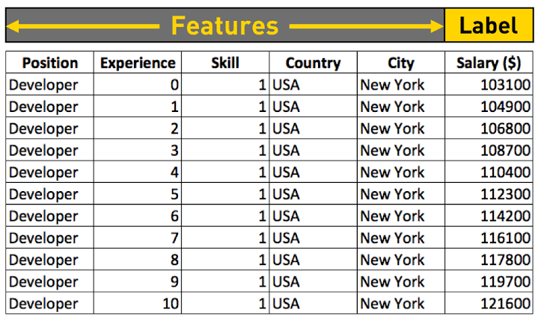
Define feature and label
Feature : “Feature is the individual independent variable that acts like a input in machine learning system.”
Label : “Label is the dependant variable that acts like a output in machine learning system.”

Slide 3
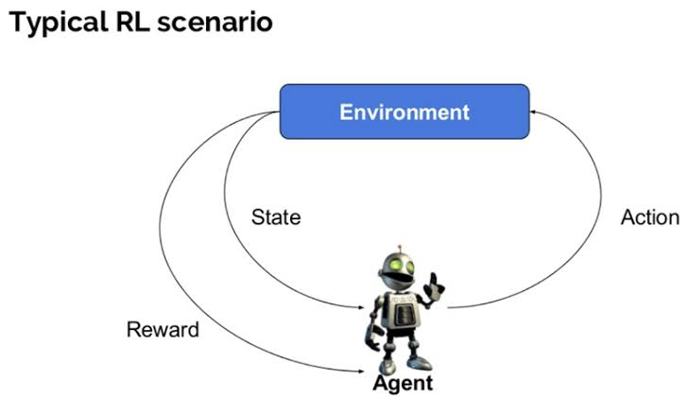
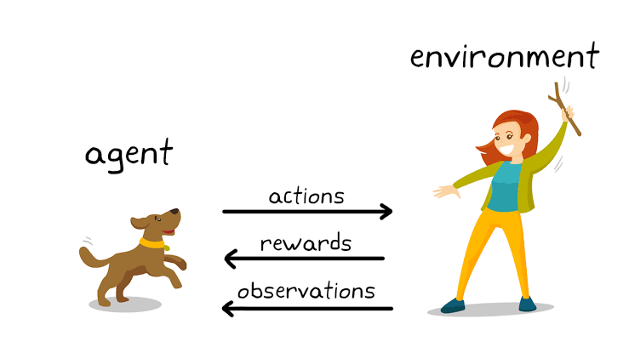
Define Reinforcement learning
Reinforcement Learning: “It is defined as the problem faced by an agent that learns through trial and error interactions with dynamic environment.”

Slide 4
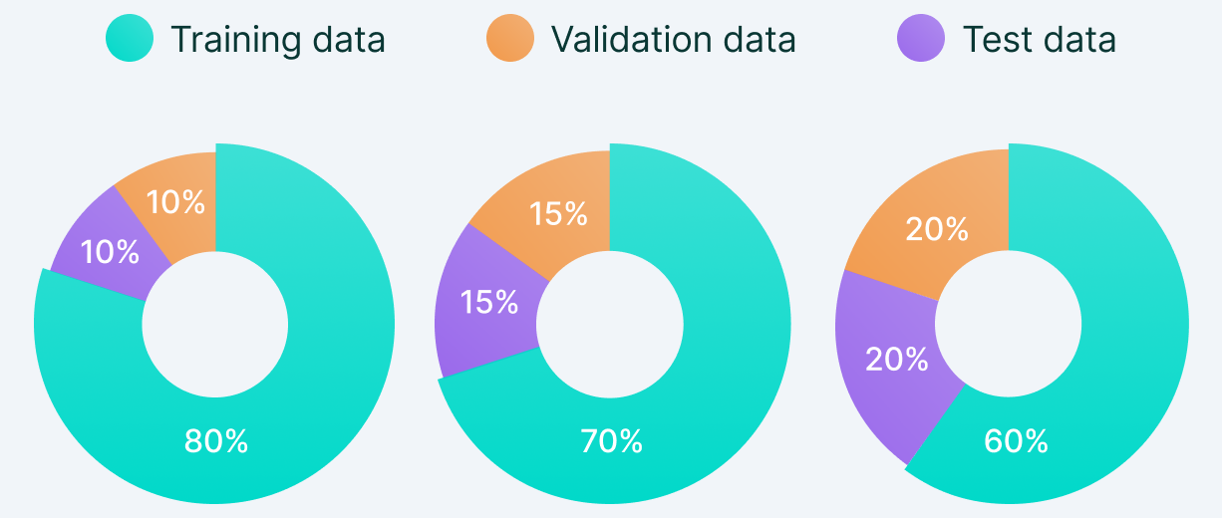
Define testing data set and training data set
Testing data set : “It is the secondary data set used to test a machine learning program after it has been trained on an initial training data set
It is used to test the accuracy of the model.
Training data set : “It is initial set of data used to help a program understand how to apply technologies to learn and produce sophisticated data.”
It is used to train the model.

Slide 5
What are different types of Machine Learning
1) Supervised Learning
-Regression
-Classification
2) Unsupervised Learning
-Clustering
3) Reinforcement Learning
-Positive
-Negative

Slide 6
Difference between supervised Learning and Unsupervised Learning
Characteristics | Supervised ML | Unsupervised ML
Definition | The machine learns by using labelled data. | The machine is trained on unlabelled data by its own without any guidance.
Types of data | Labelled data | Unlabelled data
Training | External supervision | No supervision
Accuracy | High | Low
Types of problem | Regression and classification | Clustering
Approach | Map labelled input to known output | Understands pattern and discover output
Period to train | Shorter | Longer
Algorithm | Linear regression, Logistic regression, Support Vector Machine, KNN | K-mean, C-mean
Advantage | Model that can be easily understood | Can detect unknown data
Disadvantage | Can not detect unknown data | Unpredictable result

Slide 7
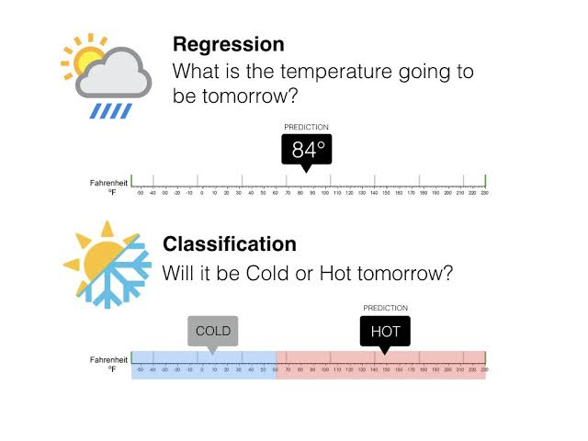
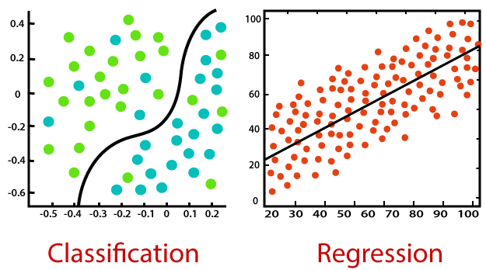
What are types of supervised learning
Types of supervised learning
-Regression
-Classification
Regression – Predicts numerical values (e.g. Predicting house price)
Classification – Predicts categorical class (e.g. Patient suffering from cancer or not)

Slide 8
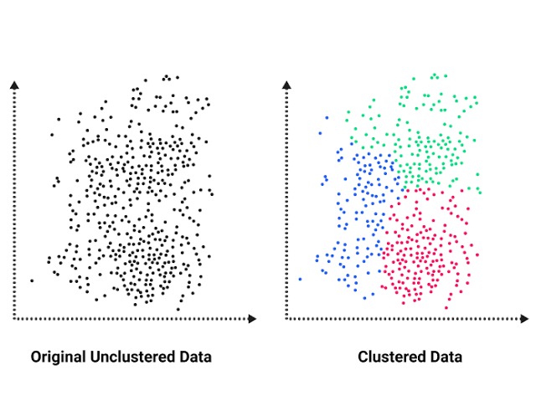
Define clustering
Clustering is the most common method of unsupervised machine learning. The clustering method involves organise unlabelled data into similar groups called cluster.
Cluster is collection of similar data item.
Goal
Find similarities
Group similar data points

